Slide 1
Object Oriented Programming using Java (ECSE102L)

Slide 2
Outline
Searching
Linear Search
Binary Search
Comparisons between Linear Search and Binary Search

Slide 3
Searching
S
There is a collection of element. We need to find an element (key).
Searching is used to find any element from a collection of elements.
Input: Set of elements.
Output: Found or Not Found. Return a value.

Slide 4
Linear Search
S
The linear search is a sequential search, which uses a loop to step through an array, starting with the first element.
It compares each element with the element that we are searching for.
It stops, when we find the element or all the elements are searched (not found).

Slide 5
Linear Search (Cont…)
S
Since the array elements are stored in linear order searching the element in the linear order make it easy and efficient.
If the collection of elements is ordered, we might not have to look at all elements.

Slide 6
Linear Search (Cont…)
S
Algorithm
Step 1: Set the first element as the current element.
Step 2: Compare the current element with the target/desire element. If matches, then go to step 5.
Step 3: If there is a next element, then set current element to next element and go to Step 2.
Step 4: Target element not found. Go to Step 6.
Step 5: Target element found and return location.
Step 6: Exit

Slide 7
Linear Search (Cont…)
S
Advantages
  It is very easy to understand and implement.
  Elements need not to be sorted.
Disadvantages
  It has very poor efficiency because it takes lots of comparisons to find an element.
  Linear search is slower than other searching algorithms.

Slide 8
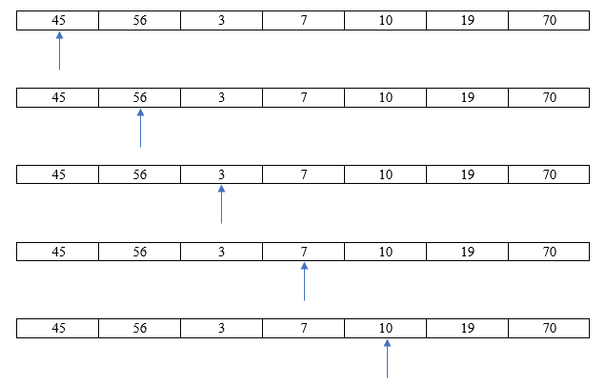
Linear Search (Cont…)
S
Example: Searching 10

Slide 9
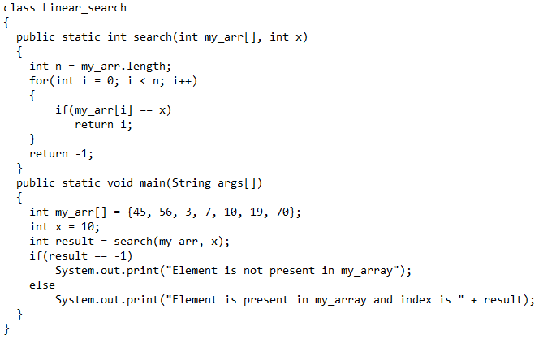
Linear Search (Cont…)
S

Slide 10
Linear Search (Cont…)
S
Output:
Element is present in my_array and index is 4

Slide 11
Linear Search (Cont…)
S
Analysis
  Best Case: O(1)
  Worst Case: O(N)

Slide 12
Binary Search
S
Binary search requires a sorted array.
Binary search cuts the “search space” in half each time.
Binary search cuts “search space” in half until the target element is found or has exhausted the all possible locations.
It uses the concept of Divide and Conquer Algorithm.

Slide 13
Binary Search
S
Divide and Conquer Algorithm: There are three steps in divide and conquer algorithm:
  Divide: In this step, a problem is divided into smaller sub-problems. This procedure is recursively executed.
  Conquer: Here, all the sub-problems are solved.
  Combine: In this step, all the results are recursively combined until they formulate a solution of the original problem.

Slide 14
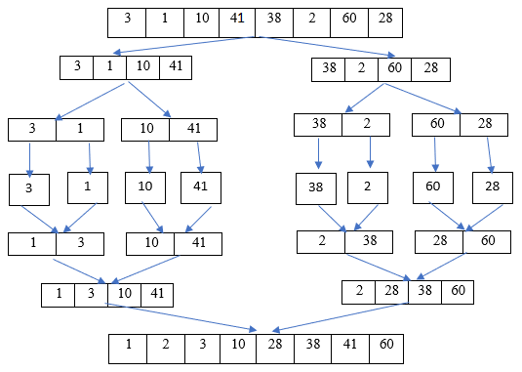
Binary Search
S
Divide and Conquer Algorithm (Cont…)

Slide 15
Binary Search (Cont…)
S
Algorithm of Binary Search
Step 1: Find middle element of the sorted array.
Step 2: Compare the value of the middle element with the target element.
Step 3: If they match, it is returned.
Step 4: If the value is less or greater than the target element, the search continues in the lower or upper half of the array.
Step 5: The same procedure mentioned in step 2-4 continues, but with the smaller part (half) of the array. The procedure continues until the target element is found or all the elements are searched.

Slide 16
Binary Search (Cont…)
S
Advantages
  It is fast.
Disadvantages
  The elements must be sorted.
  Complex.

Slide 17
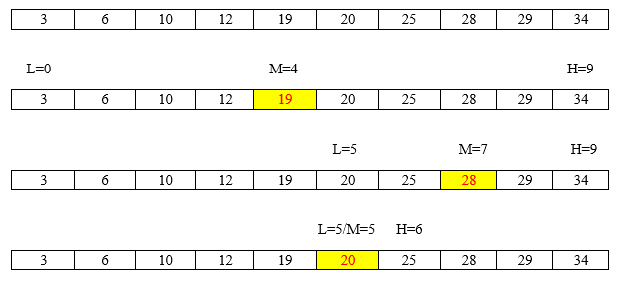
Binary Search (Cont…)
S
Example: Searching 20

Slide 18
Binary Search (Cont…)
S
Example (Cont…):
  How many search is required to find element 87 by using binary search?
2 | 4 | 7 | 10 | 15 | 17 | 36 | 47 | 51 | 53 | 56 | 60 | 76 | 80 | 87 | 99

Slide 19
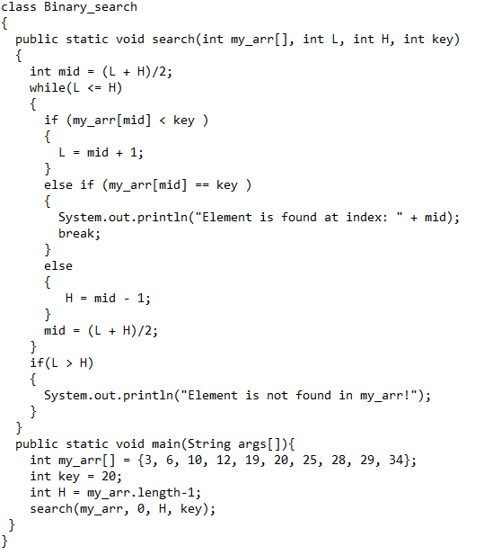
Binary Search (Cont…)
S

Slide 20
Binary Search (Cont…)
S
Output
  Element is found at index: 5

Slide 21
Binary Search (Cont…)
S
Analysis
  Best Case: O(1)
  Worst Case: O(log2N)
    Divide the elements until we find the target key.
    In each comparison, we divide the array into ½.

Slide 22
Comparisons
S
Linear Search | Binary Search
Sorted array is not required | Array must be sorted
Simple | Complex
Time complexity O(N) | Time complexity O(Log2N)
Less efficient | More efficient

Slide 23




